Slide 1
PowerCLI 201
CODE1744LV
From the Shell to Writing Scripts
Justin Sider
Chief PowerShell Officer – Belay Technologies
#CODE1744LV
Broadcom Proprietary and Confidential. Copyright © 2024 Broadcom.
All Rights Reserved. The term “Broadcom” refers to Broadcom Inc. and/or its subsidiaries.

Slide 2

Justin Sider
Blog
https://invoke-automation.blog
GitHub
https://github.com/jpsider
Twitter(X)/Slack
Jpsider
VMware Community
vExpert, VMUG leader, {Code} Coach, VMUG BOD
Chief Information Officer – Belay Technologies
Broadcom Proprietary and Confidential. Copyright © 2024 Broadcom.
All Rights Reserved. The term “Broadcom” refers to Broadcom Inc. and/or its subsidiaries.

Slide 3
Takeaways
Review the Basics
Understand the Developer Center
Convert UI Actions to PowerCLI code

Slide 4
Agenda
PowerShell Basics
What is a Script?
VMware Developer Center
PowerShell vs. C# vs. .Net
Converting Developer Center Output to Useable PowerShell/PowerCLI
Get-Member
Get-Help
Related Links
Resources

Slide 5
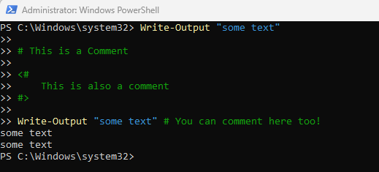
PowerShell 101
Verb-Noun (Functions)
Examples:
Get-Process
Write-Output
Get-VM
Restart-GuestOS
Approved Verbs:
Get-Verb

Slide 6
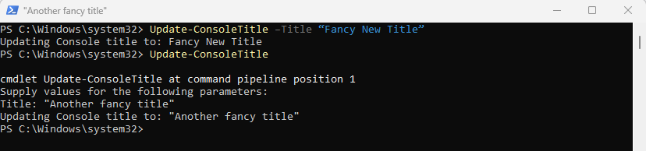
PowerShell 102
WTF – What the function?
Functions & Parameters
<Function Name> + <Parameter Name> + <Parameter Value>
Get-Process –Name “Powershell”
<Function Name> + <Parameter Name> + <Parameter Value>
Update-ConsoleTitle –Title “Fancy New Title”
If a Parameter is required, PowerShell will ask you for it!

Slide 7

PowerShell 150
Get to know your Objects
Objects
A collection of Data that represents an Item.
In PowerShell and Object is made up of 3 types of Data
Object Type
What am I?
Methods
What can you do to me?
Properties
What are the things that describe me?

Slide 8
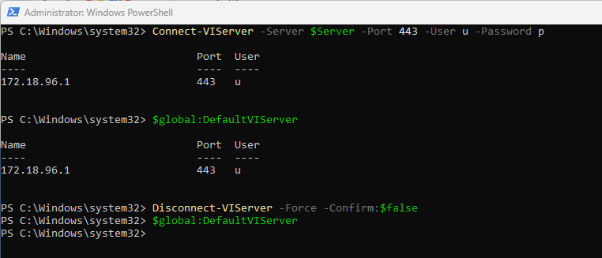
PowerCLI 101
The star of the show!
Getting Started with PowerCLI
Install the PowerCLI module
Open Powershell
Install-Module Vmware.PowerCLI
Wait a little while ☺
Connect to a vCenter
Connect-VIServer –name myvcenter –Username “administrator” –Password “VMware1!”
$Global:DefaultVIServer
Disconnect-VIServer –Force –Confirm:$false

Slide 9
What is a Script?
A script is a plain text file with one or more PowerShell Commands.
PowerShell scripts have a .ps1 file extension
Yes, You can pass in Parameters!
Not today! - but you should do some research!
Execution Policy
Comment based help
Running Scripts against Remote Computers
Exit codes
Scope
Dot Sourcing
And more!

Slide 10
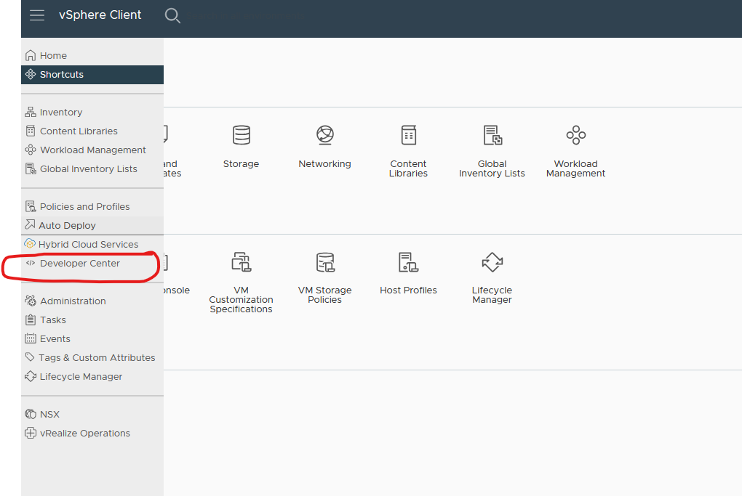
VMware Developer Center
Best thing since sliced bread!
Great tool for new developers! – Yes that means you!

Slide 11
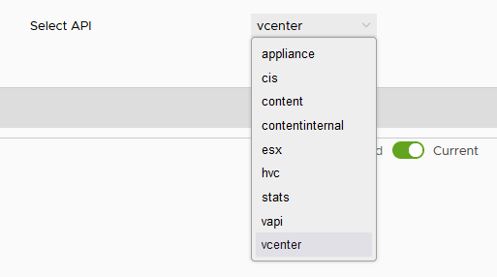
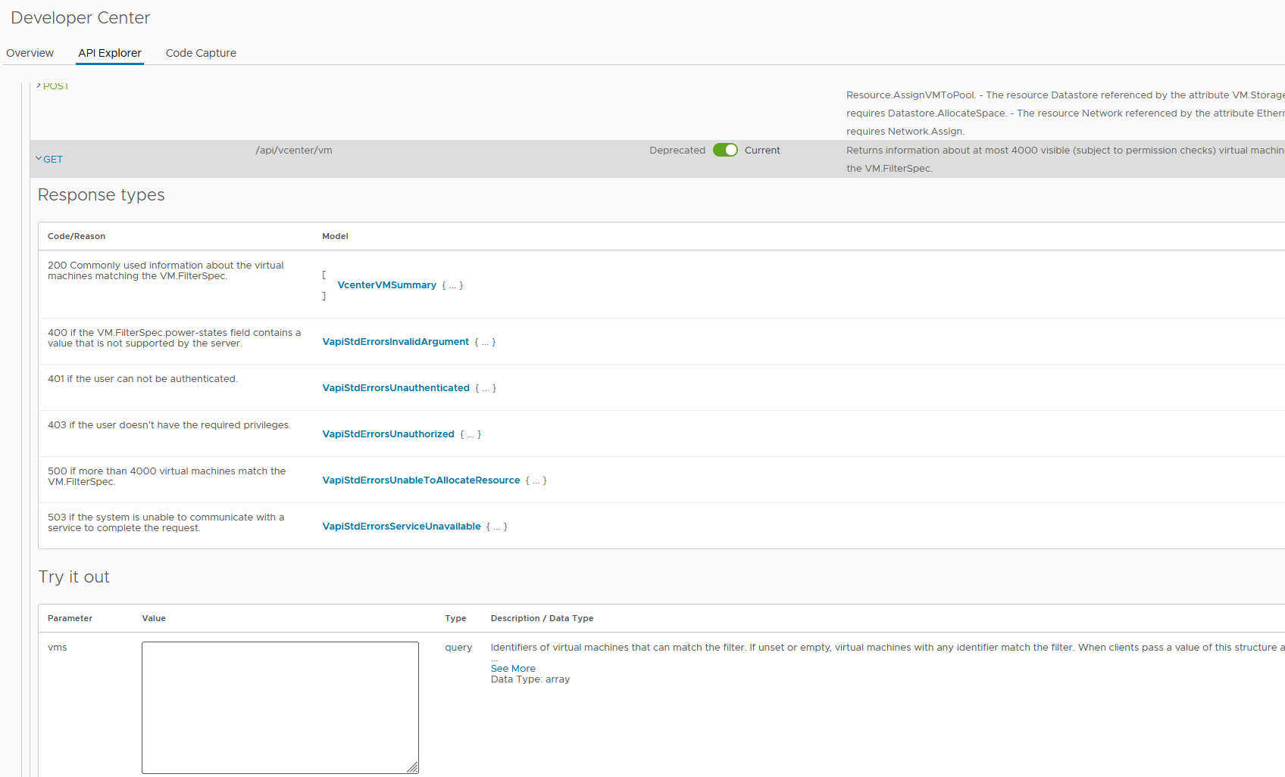
VMware Developer Center
API Explorer
Explore the REST endpoints of multiple vSphere API’s

Slide 12
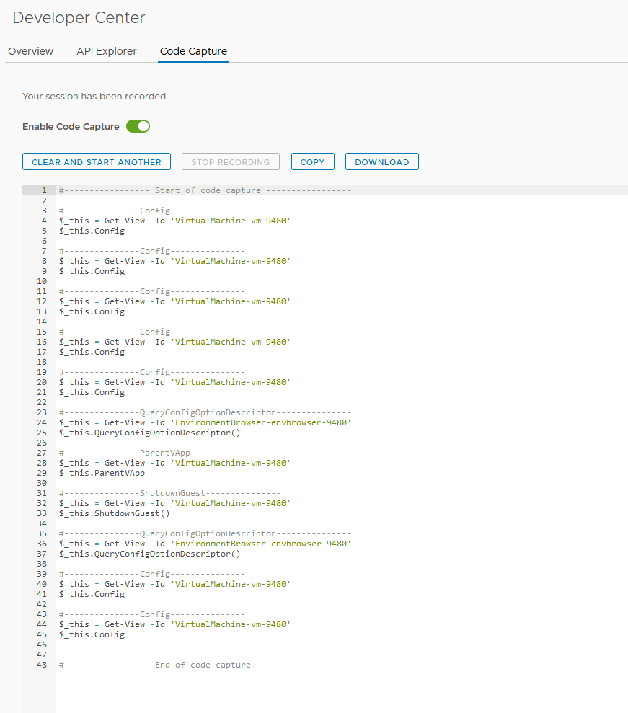
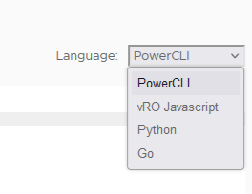
VMware Developer Center
Code Capture
Perform UI actions
Spits out “code”
Multiple language options!

Slide 13


VMware Developer Center
Rest vs. Soap
vs.

Slide 14
PowerShell vs. C# vs. .NET
Generally speaking…
PowerShell
Scripting language
Non-Compiled
C#
Programming Language Compiled
.NET (dot net)
Framework and Libraries
But there is more to the story …
Check out the PowerCLI 301 session!

Slide 15



Converting Developer Center Output to useable PowerShell/PowerCLI
This should be easy…. Thank a PowerCLI developer today!
Expectation
Reality

Slide 16
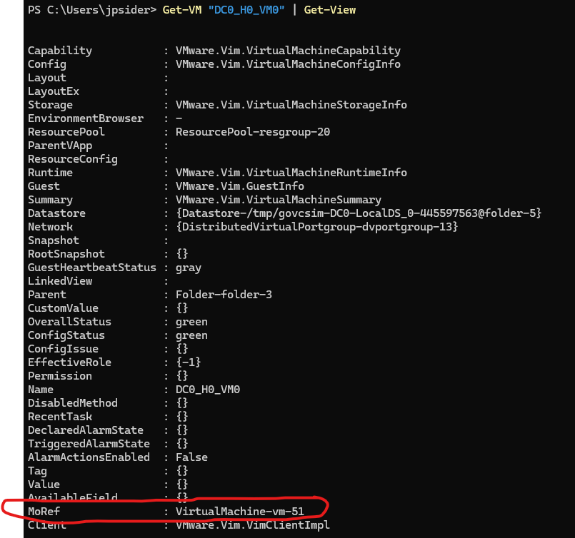
Converting Developer Center Output to useable PowerShell/PowerCLI
Get-View FTW!
MoRef – Manage Object Reference
Learn to love it!

Slide 17
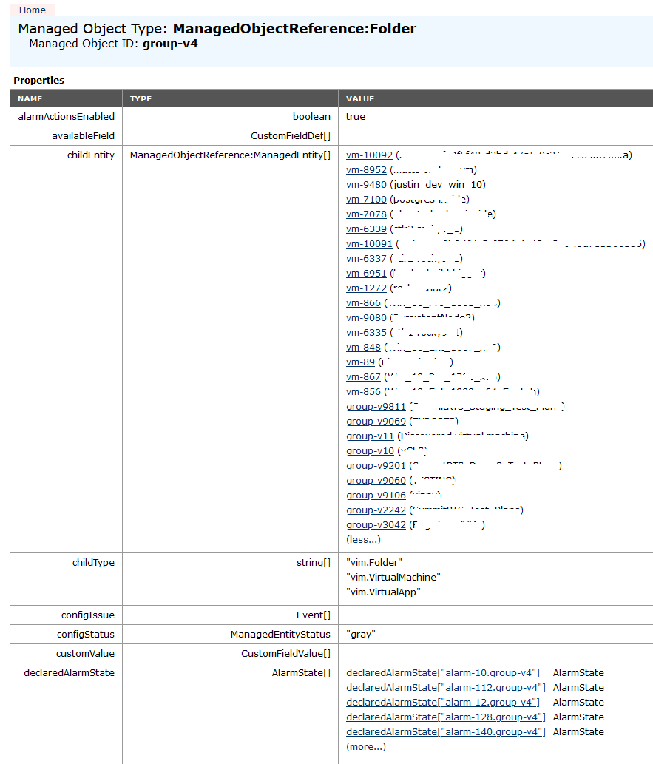
Managed Object Browser (the MOB)
Careful talking about this in Vegas
Https://<vcenter>/mob
Reality

Slide 18
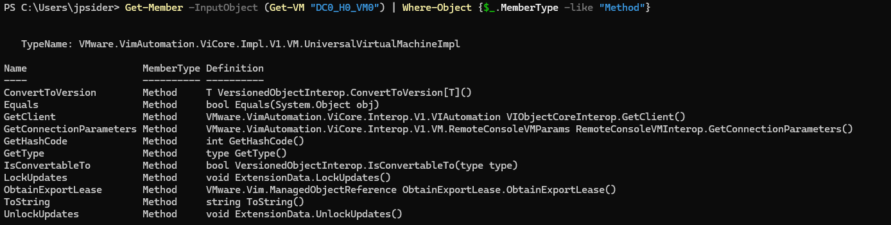
Get-Member
What methods are available?
Get-Member –InputObject (Get-VM “DC0_H0_VM0”) | Where-Object {$_.MemberType -like "Method"}
Uhhhhhh…….. Where is the ShutdownGuest Method?

Slide 19
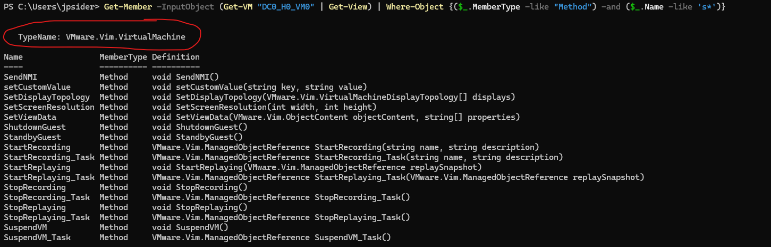
Get-Member
Good thing this is a 200 level session!
Get-Member –InputObject (Get-VM “DC0_H0_VM0” | Get-view) | Where-Object {$_.MemberType -like "Method"}

Slide 20
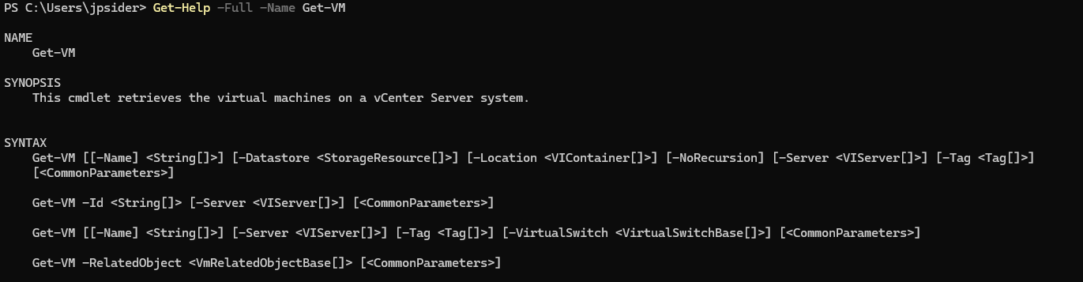
Get-Help
Use this feature!

Slide 21
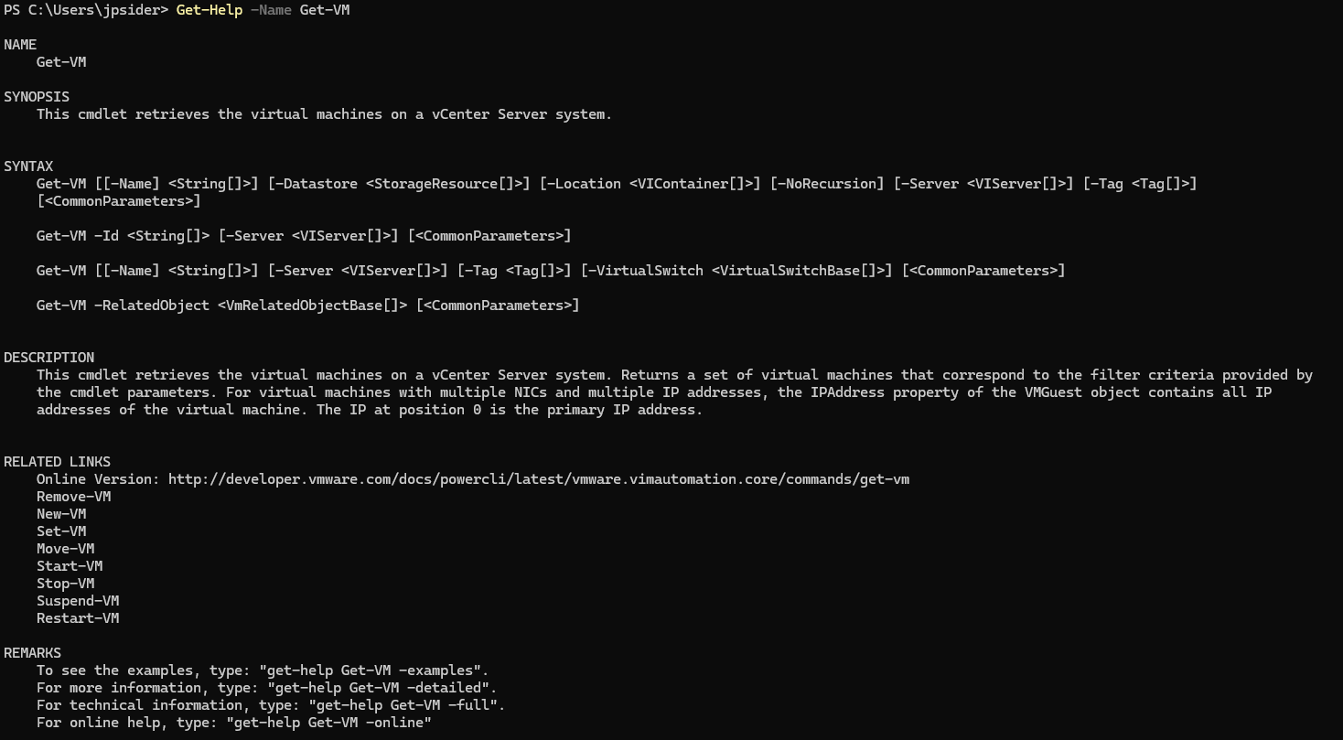
Related Links
Need more information – or related commands?

Slide 22
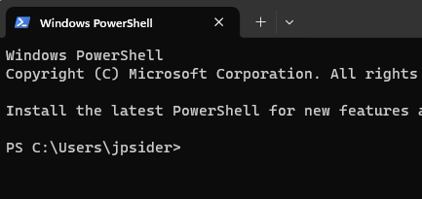

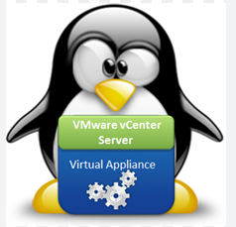

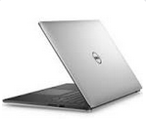
Demo Environment
Lets go Live!

Slide 23
Resources
https://developer.broadcom.com/
https://community.broadcom.com/home

Slide 24
Please take your survey.
Thank you!
https://github.com/jpsider/Invoke-Automation/tree/master/Powercli/VMwareExplore_2024
Broadcom Proprietary and Confidential. Copyright © 2024 Broadcom.
All Rights Reserved. The term “Broadcom” refers to Broadcom Inc. and/or its subsidiaries.

